Slide 1
References (2)
Jeff (CHI-HSUAN HO)

Slide 2
Intensity Extraction and Data collecting Software – Summit Grid Review, Improve & Evaluate
Jeff (CHI-HSUAN HO)

Slide 3
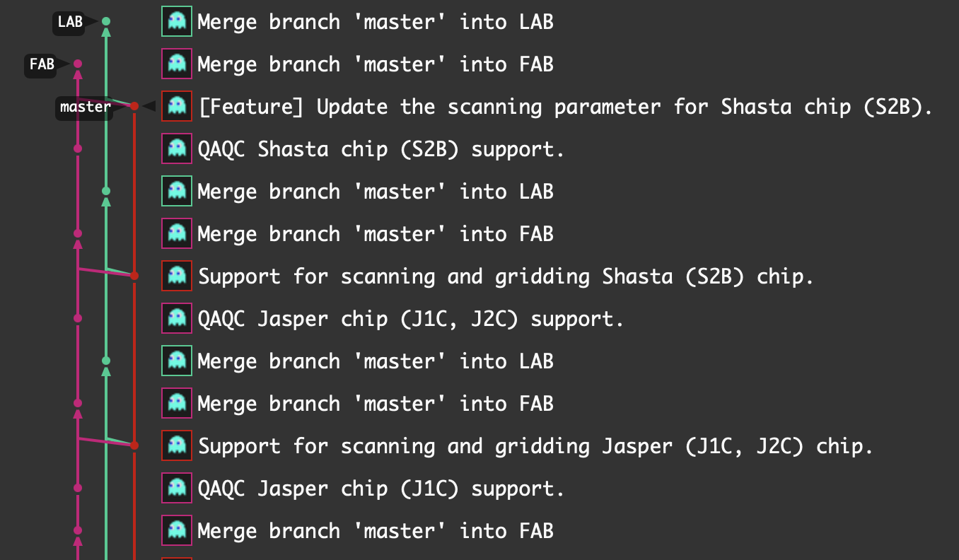
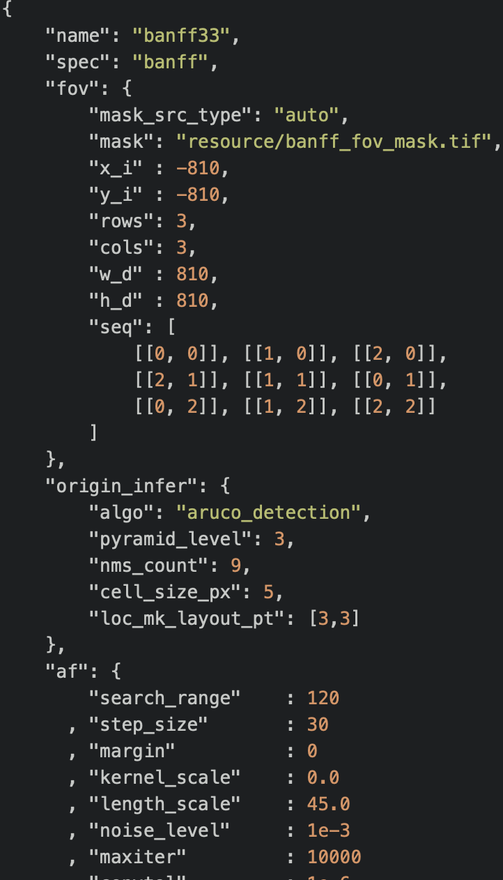
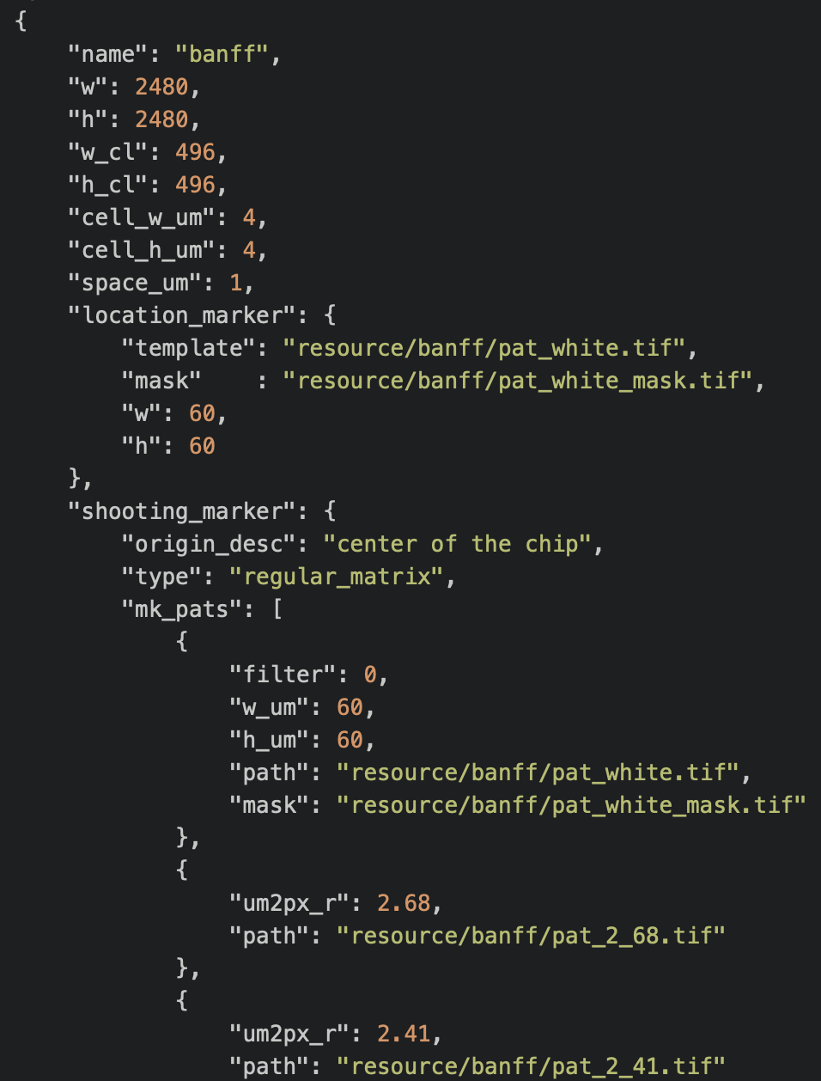
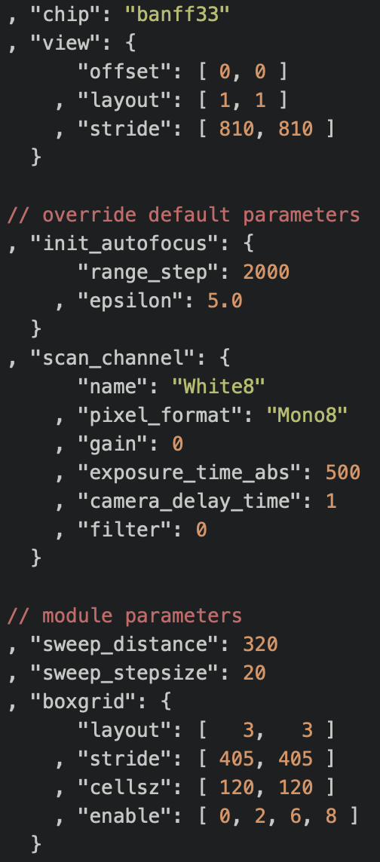
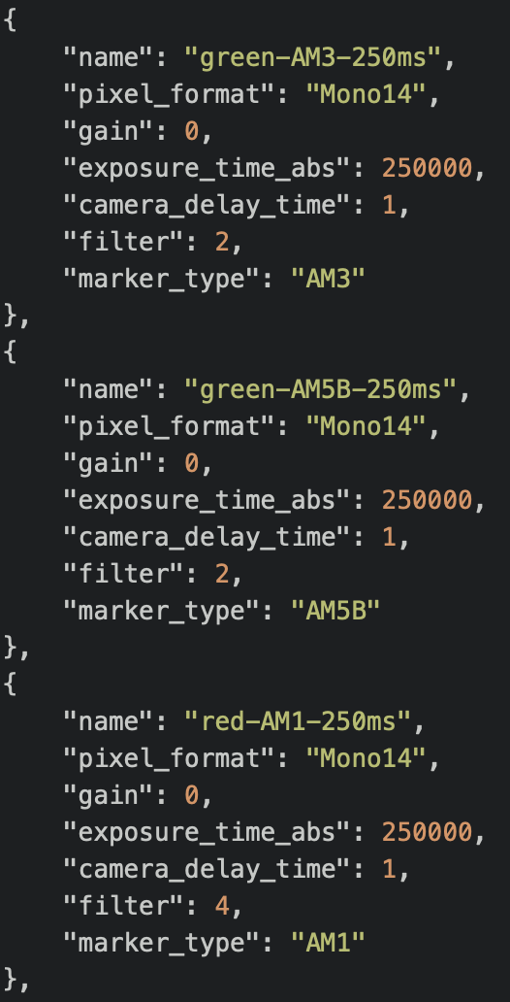
Gridding Development
Summit.Grid
Chip Spec Parameters Setup

Slide 4
Gridding Development
Summit.Grid
Bugfix for wrong nms_count (WARNING for S1C)
Original
Noise influence (WARNING for Y2B)

Slide 5
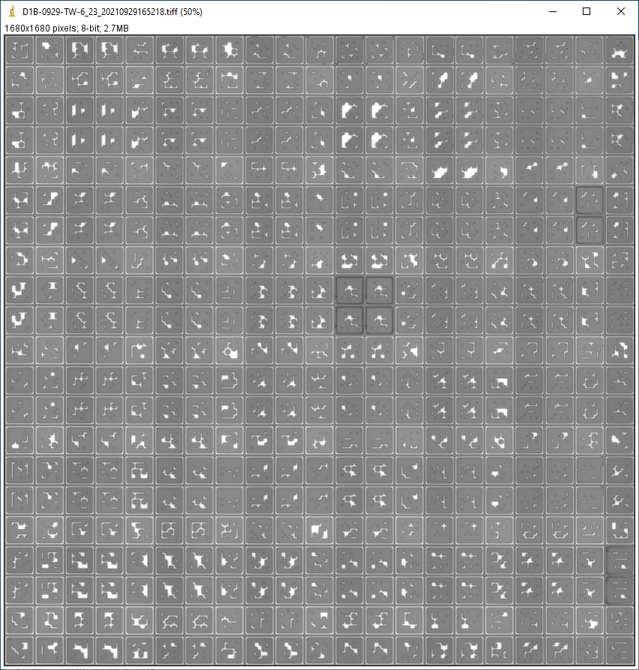
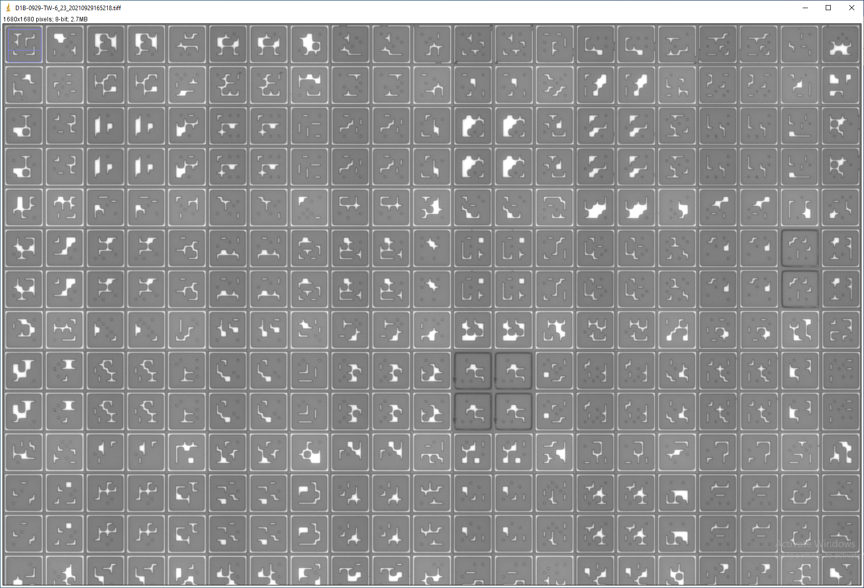
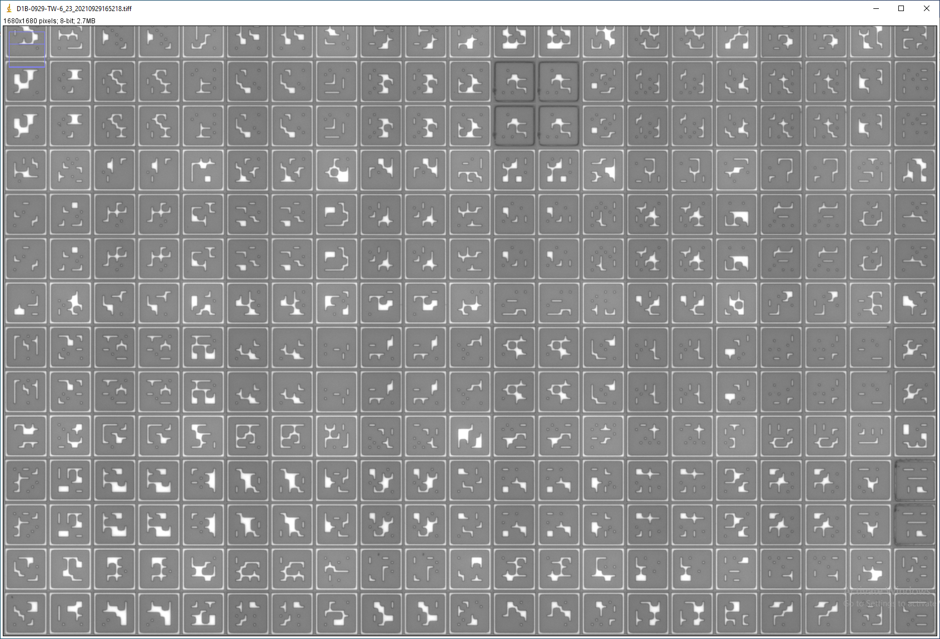
Gridding Development
Summit.Grid
Rescue mechanism for gridding bad fov (for erosion).

Slide 6
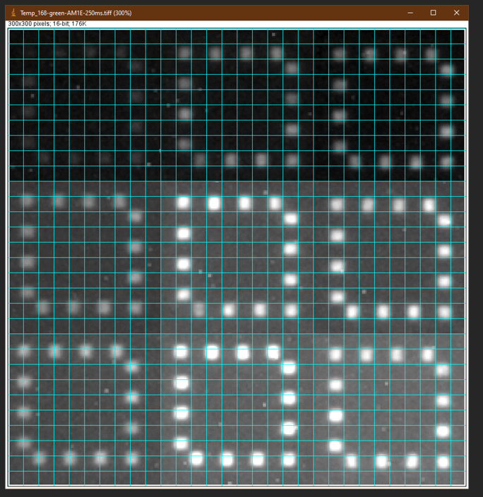
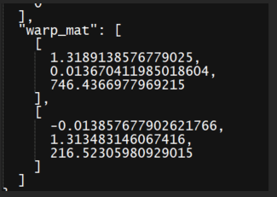
Gridding Development
Summit.Grid
PGD Images Processing.

Slide 7
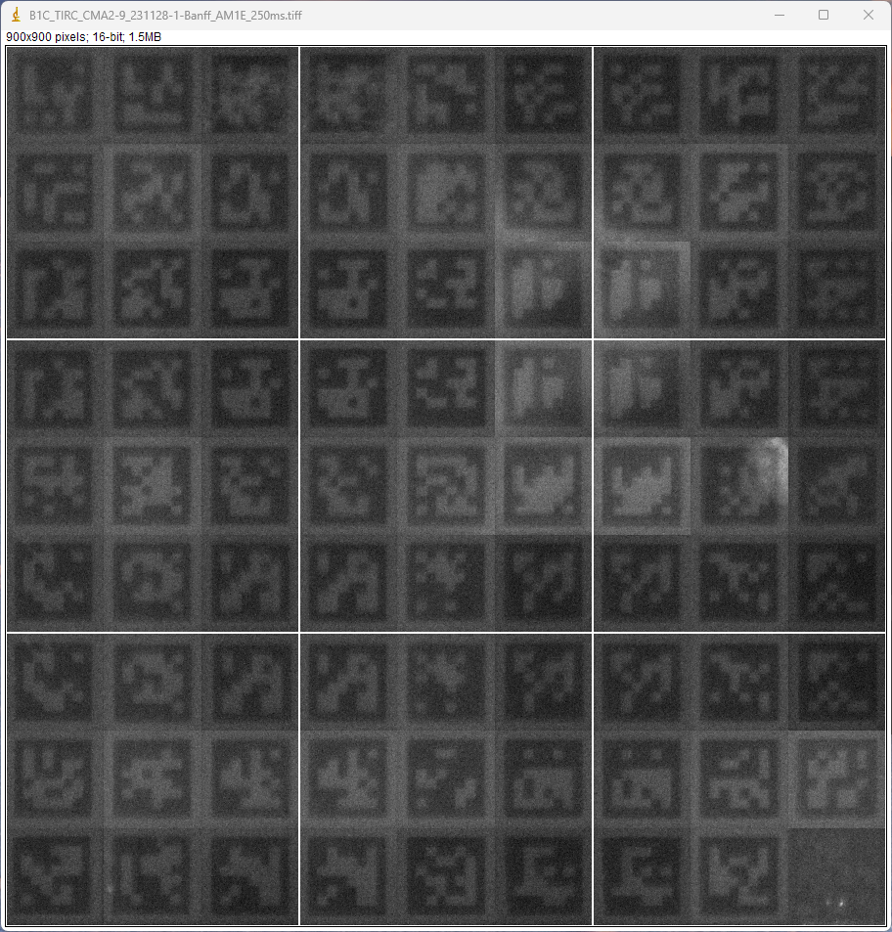
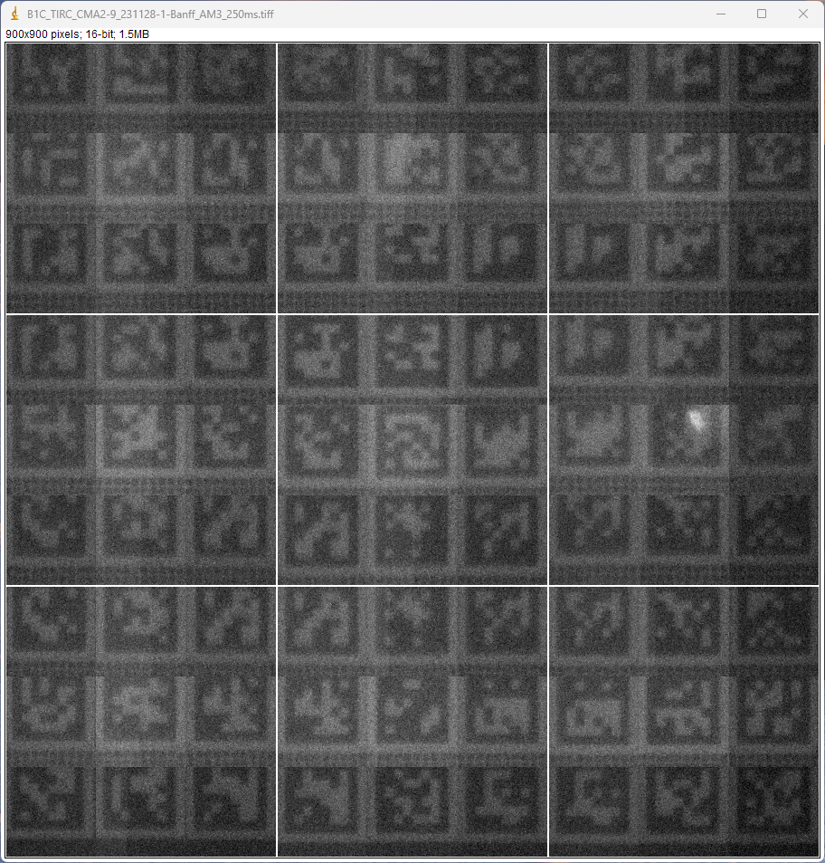
Gridding Development
Summit Grid checking support.
AM1E
AM3
Notes:
Channel name caused by hdf5
VCF definition failure: correct => A: ref, B: alt
Image convert to heatmap: Y need to be inversed.

Slide 8
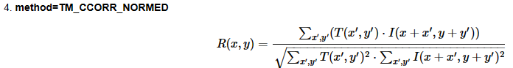
Performance for New Gridding Software
Summit.Grid
Old statistical method

Slide 9
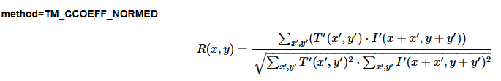
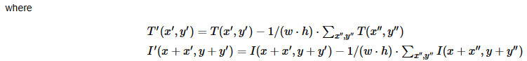
Performance for New Gridding Software
Summit.Grid
New statistical method

Slide 10
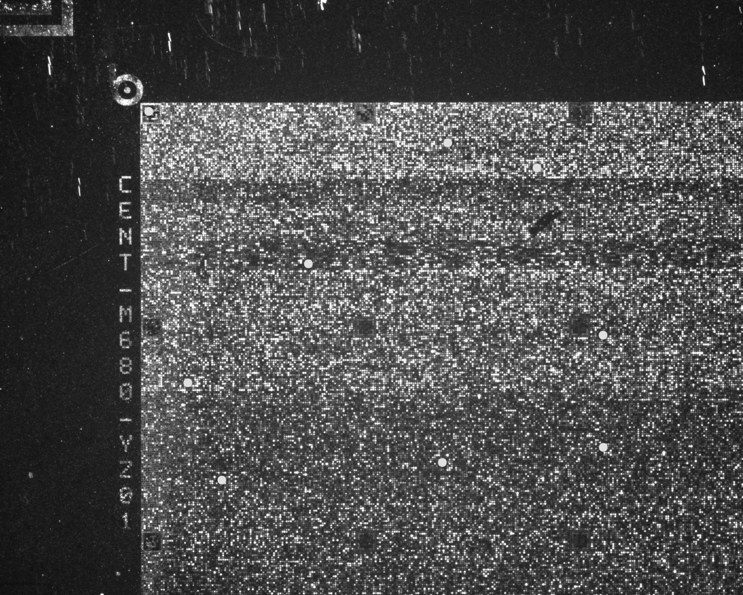
Performance for New Gridding Software
Summit.Grid
Old statistical method

Slide 11
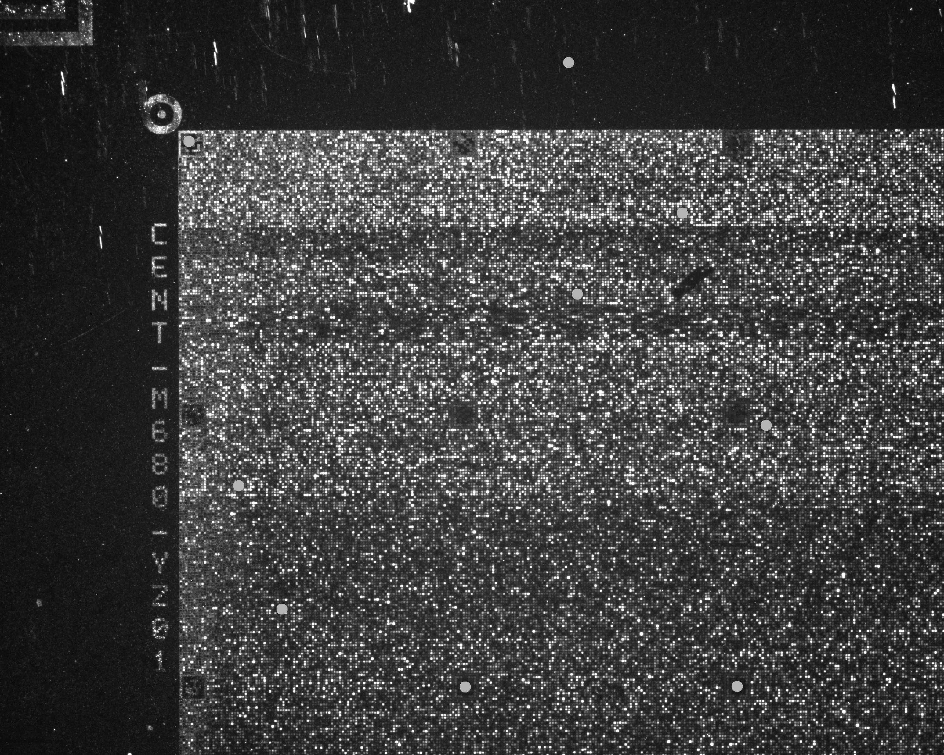
Performance for New Gridding Software
Summit.Grid
New statistical method

Slide 12
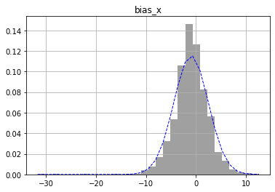
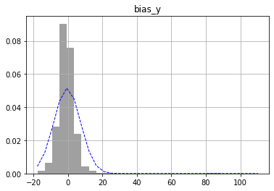
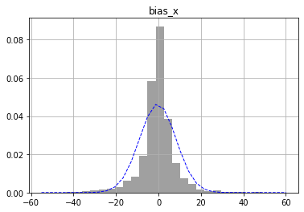
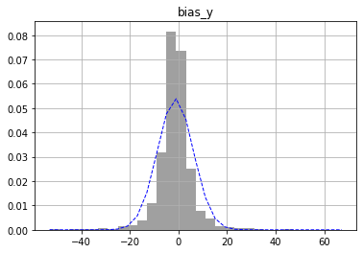
Sampling Distribution for Different Chip Scan Mode
Quick scan mode experiments
Sample: 5 YZ01 chips (7x7 FOVs) x 10 runs => 2450 FOVs
Estimation: Var(X+Y)
Bias_H
Bias_V
N (-0.97, 3.45²)
N (-0.47, 7.73²)
SUMMIT Test 2
Bias_H
Bias_V
N (-0.34, 8.60²)
N (-1.31, 7.39²)
SUMMIT Test 3

Slide 13
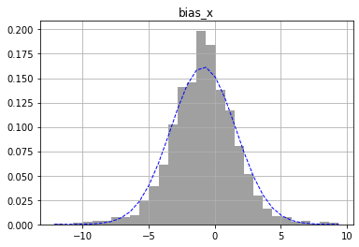
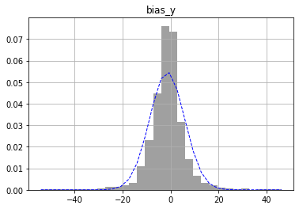
Sampling Distribution for Different Chip Scan Mode
Quick scan mode experiments
Sample: 5 YZ01 chips (7x7 FOVs) x 10 runs => 2450 FOVs
Estimation: Var(X+Y)
SUMMIT with precise sliding
N (-0.86, 2.47²)
Bias_H
N (-1.43, 7.23²)
Bias_V

Slide 14
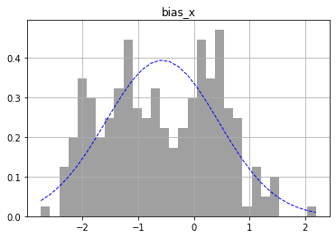
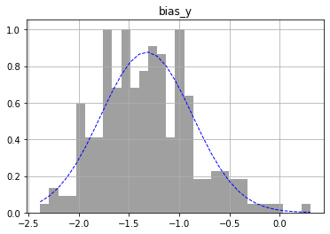
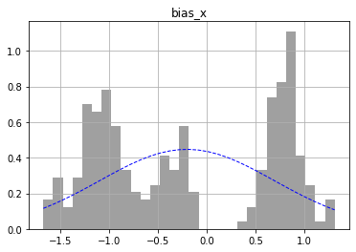
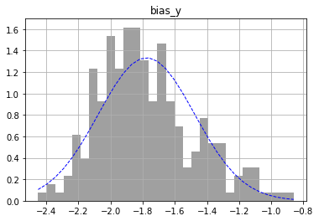
Sampling Distribution for Different Chip Scan Mode
Regular high precision mode experiments
Sample: 5 YZ01 chips (7x7 FOVs) x 1 runs => 245 FOVs
Estimation: Var(X)
N (-0.57, 1.01²)
Bias_H
N (-1.32, 0.45²)
Bias_V
SUMMIT Test 2
Bias_H
Bias_V
N (-0.20, 0.89²)
N (-1.77, 0.29²)
SUMMIT Test 3

Slide 15
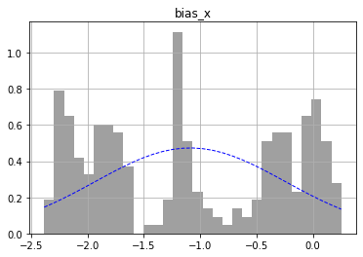
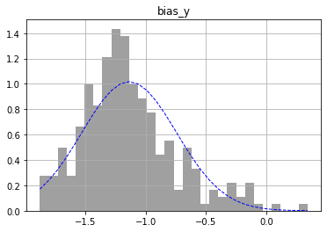
Sampling Distribution for Different Chip Scan Mode
Regular high precision mode experiments
Sample: 5 YZ01 chips (7x7 FOVs) x 1 runs => 245 FOVs
Estimation: Var(X)
SUMMIT with Precise Sliding
Bias_H
Bias_V
N (-1.09, 0.84²)
N (-1.14, 0.39²)

Slide 16
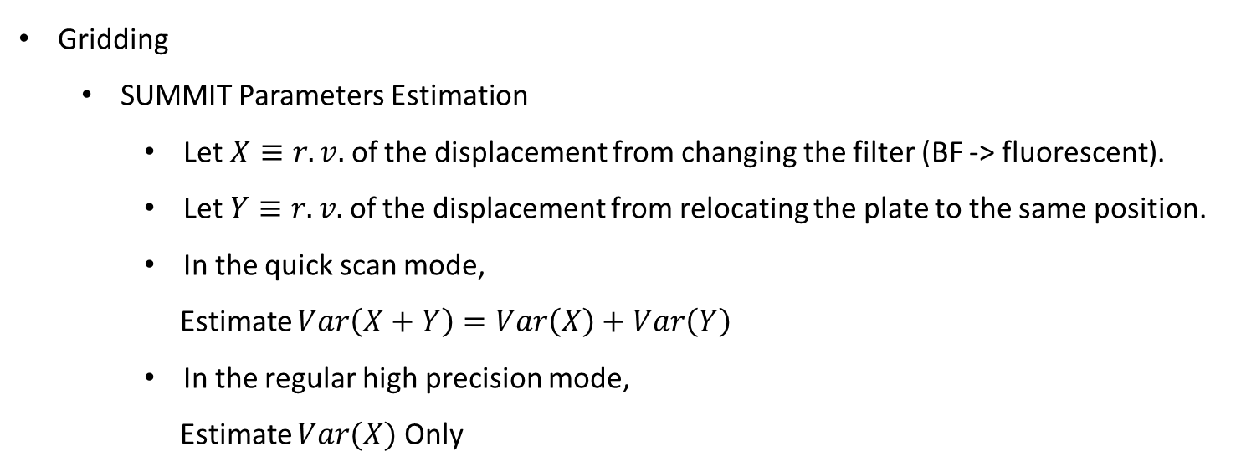
Statistical Conclusion from Experiments Results
Gridding
SUMMIT Parameters Estimation
Let $X≡r.v.$ of the displacement from changing the filter (BF -> fluorescent).
Let $Y≡r.v.$ of the displacement from relocating the plate to the same position.
In the quick scan mode,
Estimate $Var\left(X+Y\right)=Var\left(X\right)+Var\left(Y\right)$
In the regular high precision mode,
Estimate $Var(X)$ Only

Slide 17
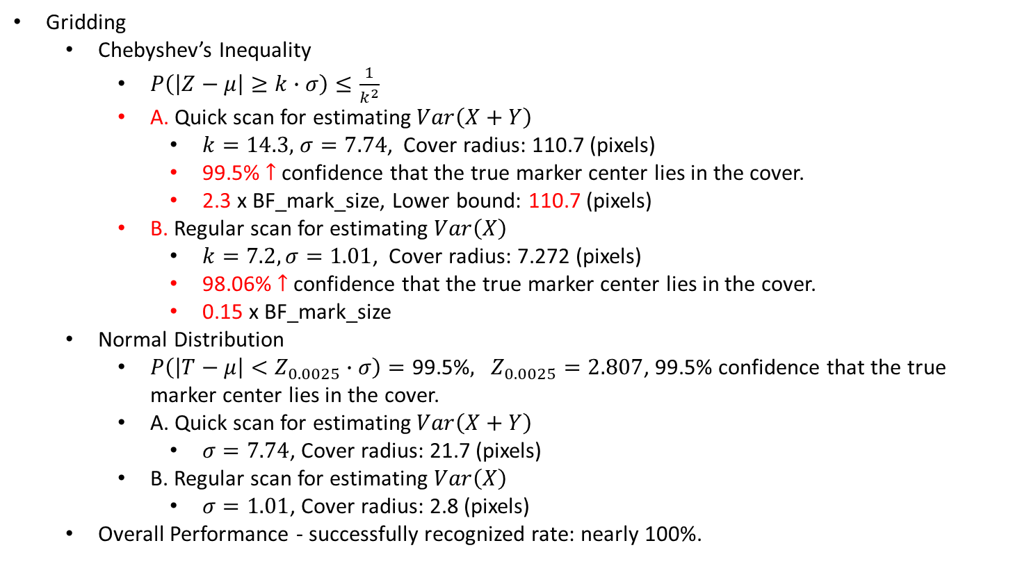
Statistical Conclusion from Experiments Results
Gridding
Chebyshev’s Inequality
$P\left(\left|Z−μ\right|≥k∙σ\right)≤\frac{1}{k^{2}}$
A. Quick scan for estimating $Var\left(X+Y\right)$
$k=14.3,$ $σ=7.74$, Cover radius: 110.7 (pixels)
99.5% $↑$ confidence that the true marker center lies in the cover.
2.3 x BF_mark_size, Lower bound: 110.7 (pixels)
B. Regular scan for estimating $Var\left(X\right)$
$k=7.2, σ=1.01$, Cover radius: 7.272 (pixels)
98.06% $↑$ confidence that the true marker center lies in the cover.
0.15 x BF_mark_size
Normal Distribution
$P\left(\left|T−μ\right|<Z_{0.0025}∙σ\right)=\text{99.5\%}, Z_{0.0025}=2.807$, 99.5% confidence that the true marker center lies in the cover.
A. Quick scan for estimating $Var\left(X+Y\right)$
$σ=7.74$, Cover radius: 21.7 (pixels)
B. Regular scan for estimating $Var\left(X\right)$
$σ=1.01$, Cover radius: 2.8 (pixels)
Overall Performance - successfully recognized rate: nearly 100%.

Slide 18
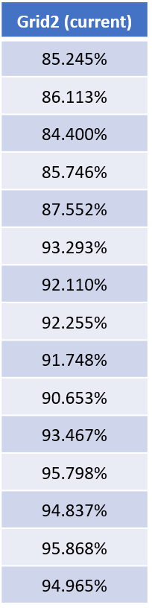
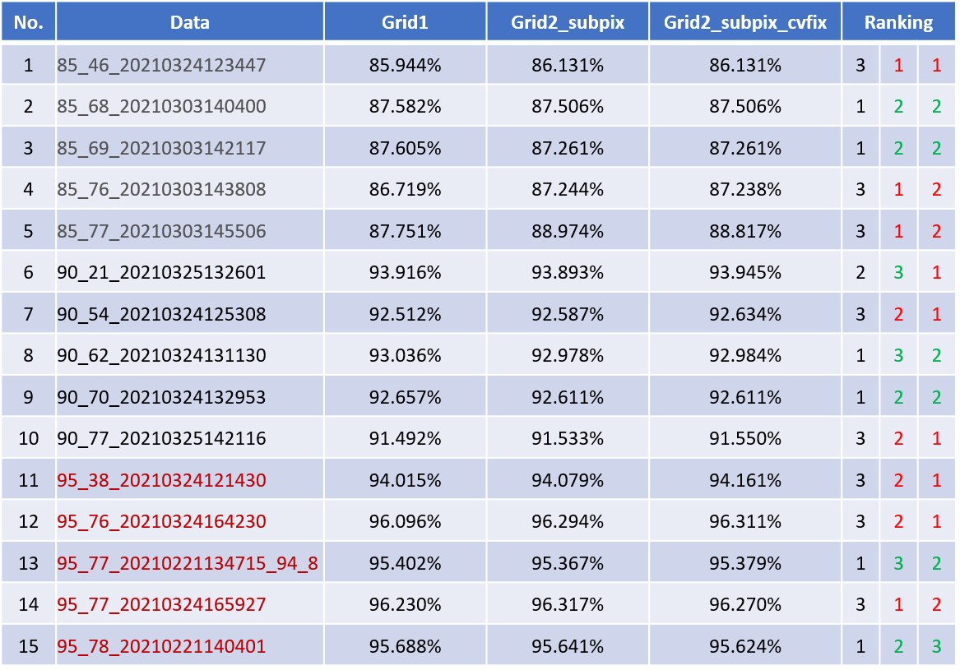
Signal Intensity Extraction Techniques Comparison
Raw Data (NPcall Analyzer)

Slide 19
Signal Intensity Extraction Techniques Comparison
Raw Data (GT Caller)
No. | Data | Grid1 | Grid2_subpix | Grid2_subpix_cvfix | Ranking
1 | 85_46_20210324123447 | 92.225% | 93.225% | 93.358% | 3 | 2 | 1
2 | 85_68_20210303140400 | 93.333% | 92.650% | 92.450% | 1 | 2 | 3
3 | 85_69_20210303142117 | 93.325% | 92.991% | 92.958% | 1 | 2 | 3
4 | 85_76_20210303143808 | 92.492% | 93.266% | 93.050% | 3 | 1 | 2
5 | 85_77_20210303145506 | 93.058% | 94.208% | 94.192% | 3 | 1 | 2
6 | 90_21_20210325132601 | 98.667% | 99.600% | 98.825% | 3 | 1 | 2
7 | 90_54_20210324125308 | 98.175% | 98.369% | 98.183% | 3 | 1 | 2
8 | 90_62_20210324131130 | 98.500% | 98.392% | 98.458% | 1 | 3 | 2
9 | 90_70_20210324132953 | 98.108% | 97.942% | 97.950% | 1 | 3 | 2
10 | 90_77_20210325142116 | 97.950% | 98.158% | 98.158% | 3 | 1 | 1
11 | 95_38_20210324121430 | 99.092% | 99.008% | 99.025% | 1 | 3 | 2
12 | 95_76_20210324164230 | 99.666% | 99.666% | 99.683% | 2 | 2 | 1
13 | 95_77_20210221134715_94_8 | 99.392% | 99.416% | 99.408% | 3 | 1 | 2
14 | 95_77_20210324165927 | 99.583% | 99.608% | 99.608% | 3 | 1 | 1
15 | 95_78_20210221140401 | 99.367% | 99.316% | 99.333% | 1 | 3 | 2

Slide 20
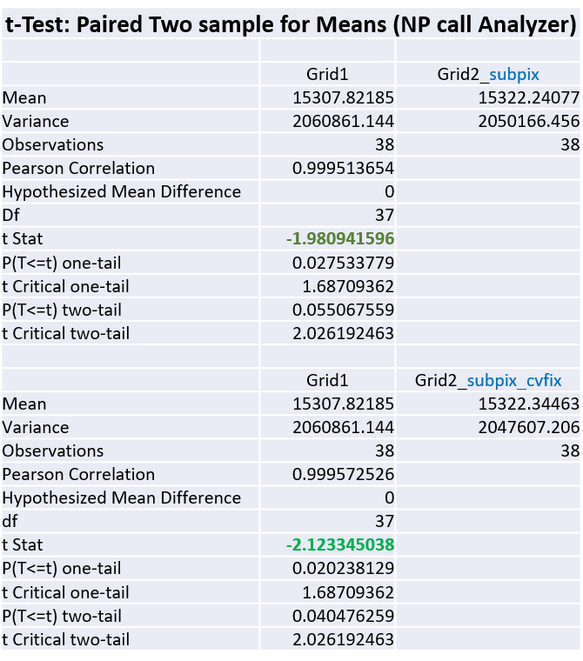
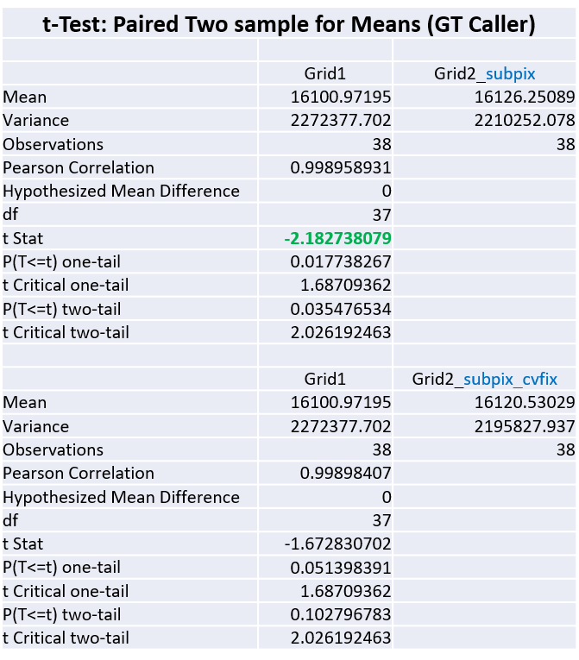
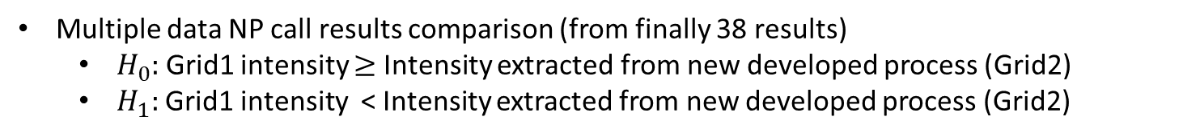
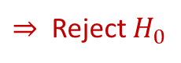

Signal Intensity Extraction Techniques Comparison
Multiple data NP call results comparison (from finally 38 results)
$H_{0}:$ Grid1 intensity $≥$ Intensity extracted from new developed process (Grid2)
$H_{1}:$Grid1 intensity < Intensity extracted from new developed process (Grid2)
$⇒$ Reject $H_{0}$
$⇒$ Reject $H_{0}$

Slide 21
Normal Gamma Background Correction & Data Preprocess
Jeff (CHI-HSUAN HO)

Slide 22
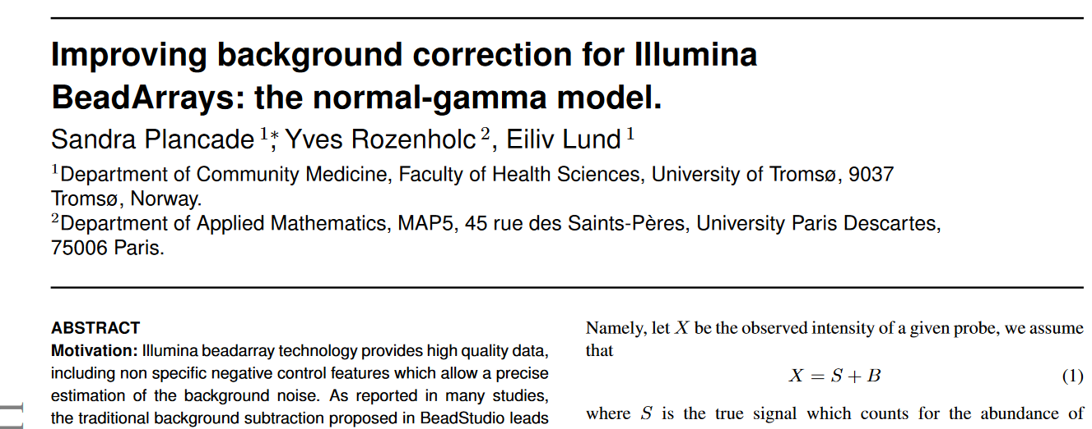
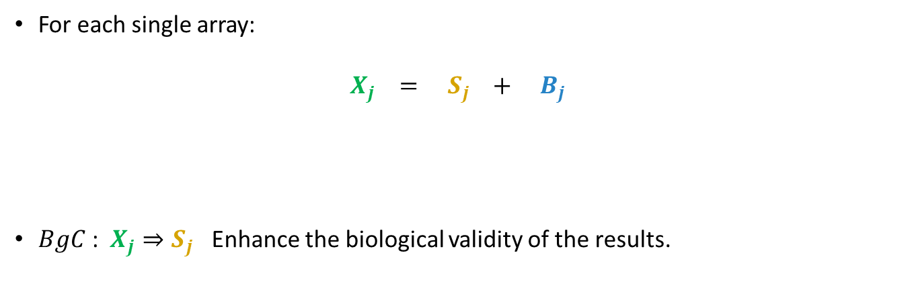
Model Background and Introduction
Model Assumption
For each single array:
$$X_{j} = S_{j} + B_{j}$$
$BgC$: $X_{j}⇒S_{j}$ Enhance the biological validity of the results.

Slide 23
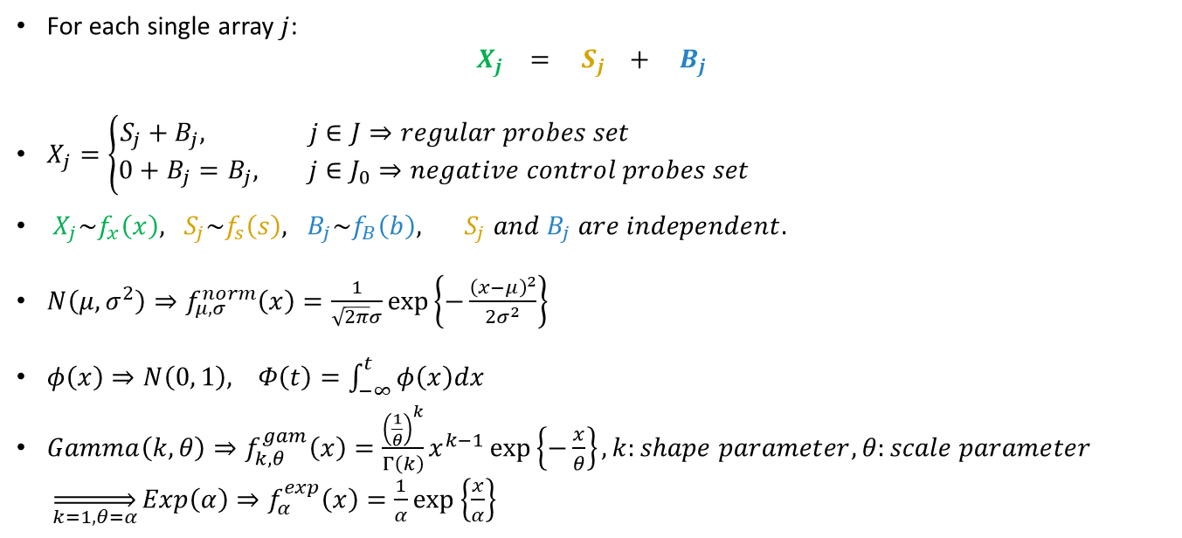
Methods and Materials
Models and Notations
For each single array $j$:
$$X_{j} = S_{j} + B_{j}$$
$X_{j}=\left\{\begin{aligned}S_{j}+B_{j}, j∈J⇒regular probes set \\ 0+B_{j}=B_{j}, j∈J_{0}⇒negative control probes set\end{aligned}\right.$
$X_{j}\sim f_{x}\left(x\right), S_{j}\sim f_{s}\left(s\right), B_{j}\sim f_{B}\left(b\right), S_{j} and B_{j} are independent.$
$N\left(μ, σ^{2}\right)⇒f_{μ, σ}^{norm}\left(x\right)=\frac{1}{\sqrt{2π}σ}\exp\left\{−\frac{{\left(x−μ\right)}^{2}}{2σ^{2}}\right\}$
$φ\left(x\right)⇒N\left(0, 1\right), Φ\left(t\right)=\int_{−∞}^{t}{φ\left(x\right)dx}$
$Gamma\left(k, θ\right)⇒f_{k, θ}^{gam}\left(x\right)=\frac{{\left(\frac{1}{θ}\right)}^{k}}{Γ\left(k\right)}x^{k−1}\exp\left\{−\frac{x}{θ}\right\}, k:shape parameter, θ:scale parameter$
$\overset{⇒}{k=1, θ=α}Exp\left(α\right)⇒f_{α}^{exp}\left(x\right)=\frac{1}{α}\exp\left\{\frac{x}{α}\right\}$

Slide 24
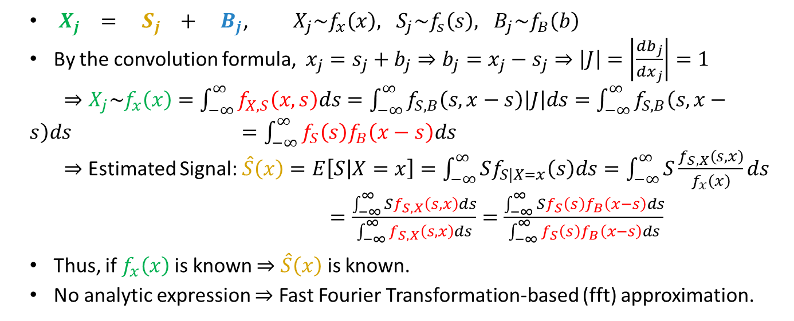
Methods and Materials
Models and Notations
$X_{j} = S_{j} + B_{j}$, ${ X}_{j}\sim f_{x}\left(x\right), S_{j}\sim f_{s}\left(s\right), B_{j}\sim f_{B}\left(b\right)$
By the convolution formula, $x_{j}=s_{j}+b_{j}⇒b_{j}=x_{j}−s_{j}⇒\left|J\right|=\left|\frac{db_{j}}{dx_{j}}\right|=1$
$⇒X_{j}\sim f_{x}\left(x\right)=\int_{−∞}^{∞}{f_{X,S}\left(x, s\right)ds}=\int_{−∞}^{∞}{f_{S, B}\left(s, x−s\right)\left|J\right|ds}=\int_{−∞}^{∞}{f_{S,B}\left(s, x−s\right)ds}= =\int_{−∞}^{∞}{f_{S}\left(s\right)f_{B}\left(x−s\right)ds}$
$⇒$ Estimated Signal: $\hat{S}\left(x\right)=E\left[S | X=x\right]=\int_{−∞}^{∞}{Sf_{S|X=x}\left(s\right)ds}=\int_{−∞}^{∞}{S\frac{f_{S,X}\left(s, x\right)}{f_{x}\left(x\right)}ds}$
$=\frac{\int_{−∞}^{∞}{Sf_{S,X}\left(s, x\right)ds}}{\int_{−∞}^{∞}{f_{S,X}\left(s, x\right)ds}}=\frac{\int_{−∞}^{∞}{Sf_{S}\left(s\right)f_{B}\left(x−s\right)ds}}{\int_{−∞}^{∞}{f_{S}\left(s\right)f_{B}\left(x−s\right)ds}}$
Thus, if $f_{x}\left(x\right)$is known $⇒$ $\hat{S}\left(x\right)$ is known.
No analytic expression $⇒$ Fast Fourier Transformation-based (fft) approximation.

Slide 25
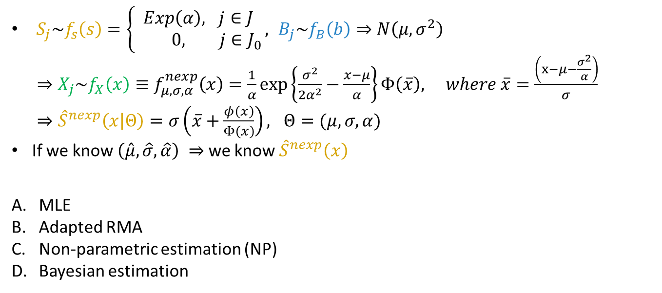
Methods and Materials
The normexp Model
$S_{j}\sim f_{s}\left(s\right)=\left\{\begin{aligned}Exp\left(α\right), j∈J \\ 0, j∈J_{0}\end{aligned}\right., B_{j}\sim f_{B}\left(b\right)⇒N\left(μ, σ^{2}\right)$
$⇒X_{j}\sim f_{X}\left(x\right)≡f_{μ, σ, α}^{nexp}\left(x\right)=\frac{1}{α}\exp\left\{\frac{σ^{2}}{2α^{2}}−\frac{x−μ}{α}\right\}Φ\left(\overline{x}\right), where \overline{x}=\frac{\left(x−μ−\frac{σ^{2}}{α}\right)}{σ}$
$⇒{\hat{S}}^{nexp}\left(x | Θ\right)=σ\left(\overline{x}+\frac{φ\left(\overline{x}\right)}{Φ\left(\overline{x}\right)}\right), Θ=(μ, σ, α)$
If we know $\left(\hat{μ}, \hat{σ},\hat{α}\right) ⇒$ we know ${\hat{S}}^{nexp}\left(x\right)$
MLE
Adapted RMA
Non-parametric estimation (NP)
Bayesian estimation
The Parameter Estimation of normexp Model

Slide 26
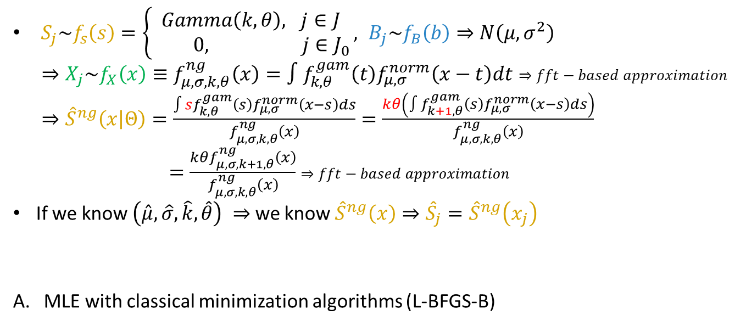
Methods and Materials
The normal-gamma Model
$S_{j}\sim f_{s}\left(s\right)=\left\{\begin{aligned}Gamma\left(k, θ\right), j∈J \\ 0, j∈J_{0}\end{aligned}\right., B_{j}\sim f_{B}\left(b\right)⇒N\left(μ, σ^{2}\right)$
$⇒X_{j}\sim f_{X}\left(x\right)≡f_{μ, σ, k, θ}^{ng}\left(x\right)=∫f_{k, θ}^{gam}\left(t\right)f_{μ, σ}^{norm}\left(x−t\right)dt⇒fft−based approximation$
$⇒{\hat{S}}^{ng}\left(x | Θ\right)=\frac{∫sf_{k, θ}^{gam}\left(s\right)f_{μ, σ}^{norm}\left(x−s\right)ds}{f_{μ, σ, k, θ}^{ng}\left(x\right)}=\frac{kθ\left(∫f_{k+1, θ}^{gam}\left(s\right)f_{μ, σ}^{norm}\left(x−s\right)ds\right)}{f_{μ, σ, k, θ}^{ng}\left(x\right)}$
$=\frac{kθf_{μ, σ, k+1, θ}^{ng}\left(x\right)}{f_{μ, σ, k, θ}^{ng}\left(x\right)}$ $⇒fft−based approximation$
If we know $\left(\hat{μ}, \hat{σ}, \hat{k},\hat{θ}\right) ⇒$ we know ${\hat{S}}^{ng}\left(x\right)⇒{{\hat{S}}_{j}=\hat{S}}^{ng}\left(x_{j}\right)$
MLE with classical minimization algorithms (L-BFGS-B)
The Parameter Estimation of normal-gamma Model

Slide 27
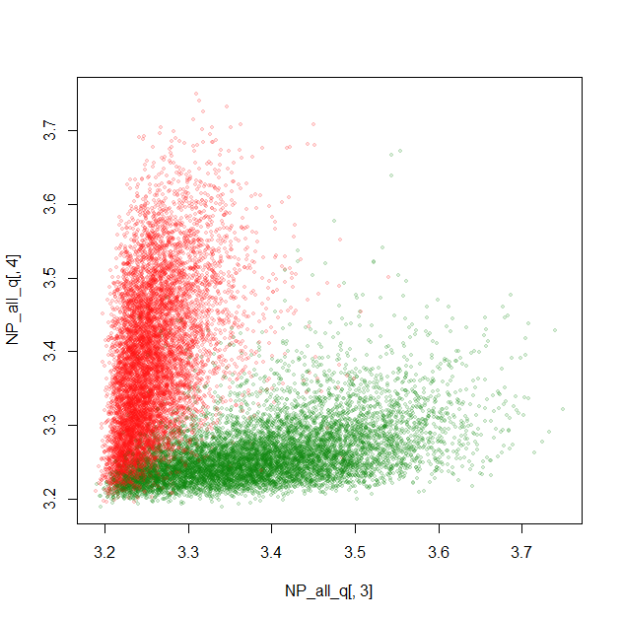
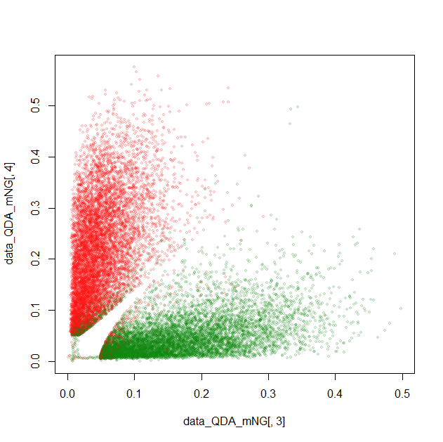
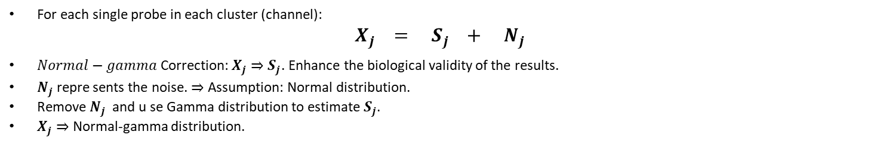
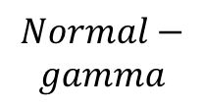
Performance on the Real Data
Normal-gamma BgC.
For each single probe in each cluster (channel):
$$X_{j} = S_{j} + N_{j}$$
$Normal−gamma$Correction: $X_{j}⇒S_{j}$. Enhance the biological validity of the results.
$N_{j}$ repre sents the noise. $⇒$ Assumption: Normal distribution.
Remove $N_{j}$ and u se Gamma distribution to estimate $S_{j}$.
$X_{j}⇒$ Normal-gamma distribution.
$$Normal−$$
$$gamma$$
e.g. log(log(Chip 121))

Slide 28
Performance on the Real Data
GMM-EM + Normal-gamma BgC.
Set the related environment in R. (Data Preprocess, NP Probes, QN & log, QDA)
Set the corresponding evaluation tools in R. (NP call rate, No call rate)
Run the GMM-EM in R. (10 times => max NP call.)
Run the normal-gamma correction (all together) before running QDA.
Debug for the no call rate in the NP call analyzer.
An example: NP call Analyzer: NP call: 94.4%, call: 66.9%
NP call (log(log(·)))
GMM + EM | 94.2308%
QDA | 94.5863%
ALL_NG + QDA | 94.2774%
Call rate (log(log(·)))
GMM + EM | 66.8298%
QDA | 67.8205%
ALL_NG + QDA | 67.7681%

Slide 29
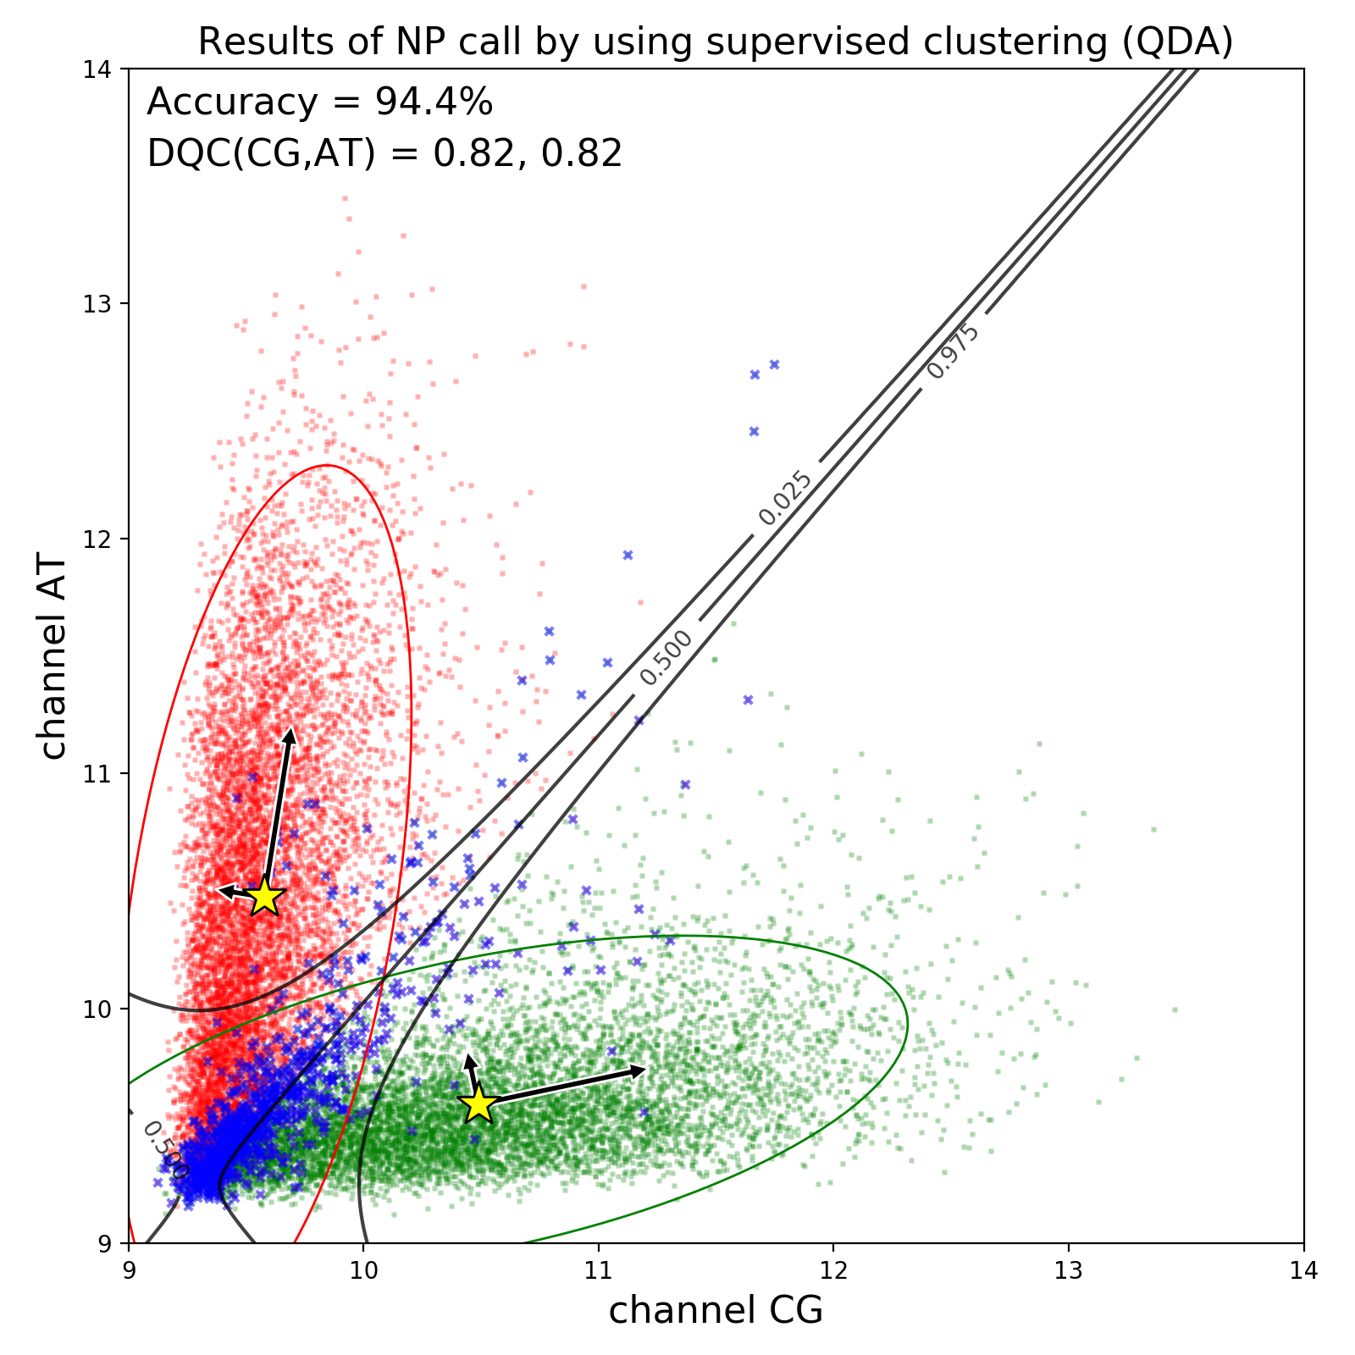
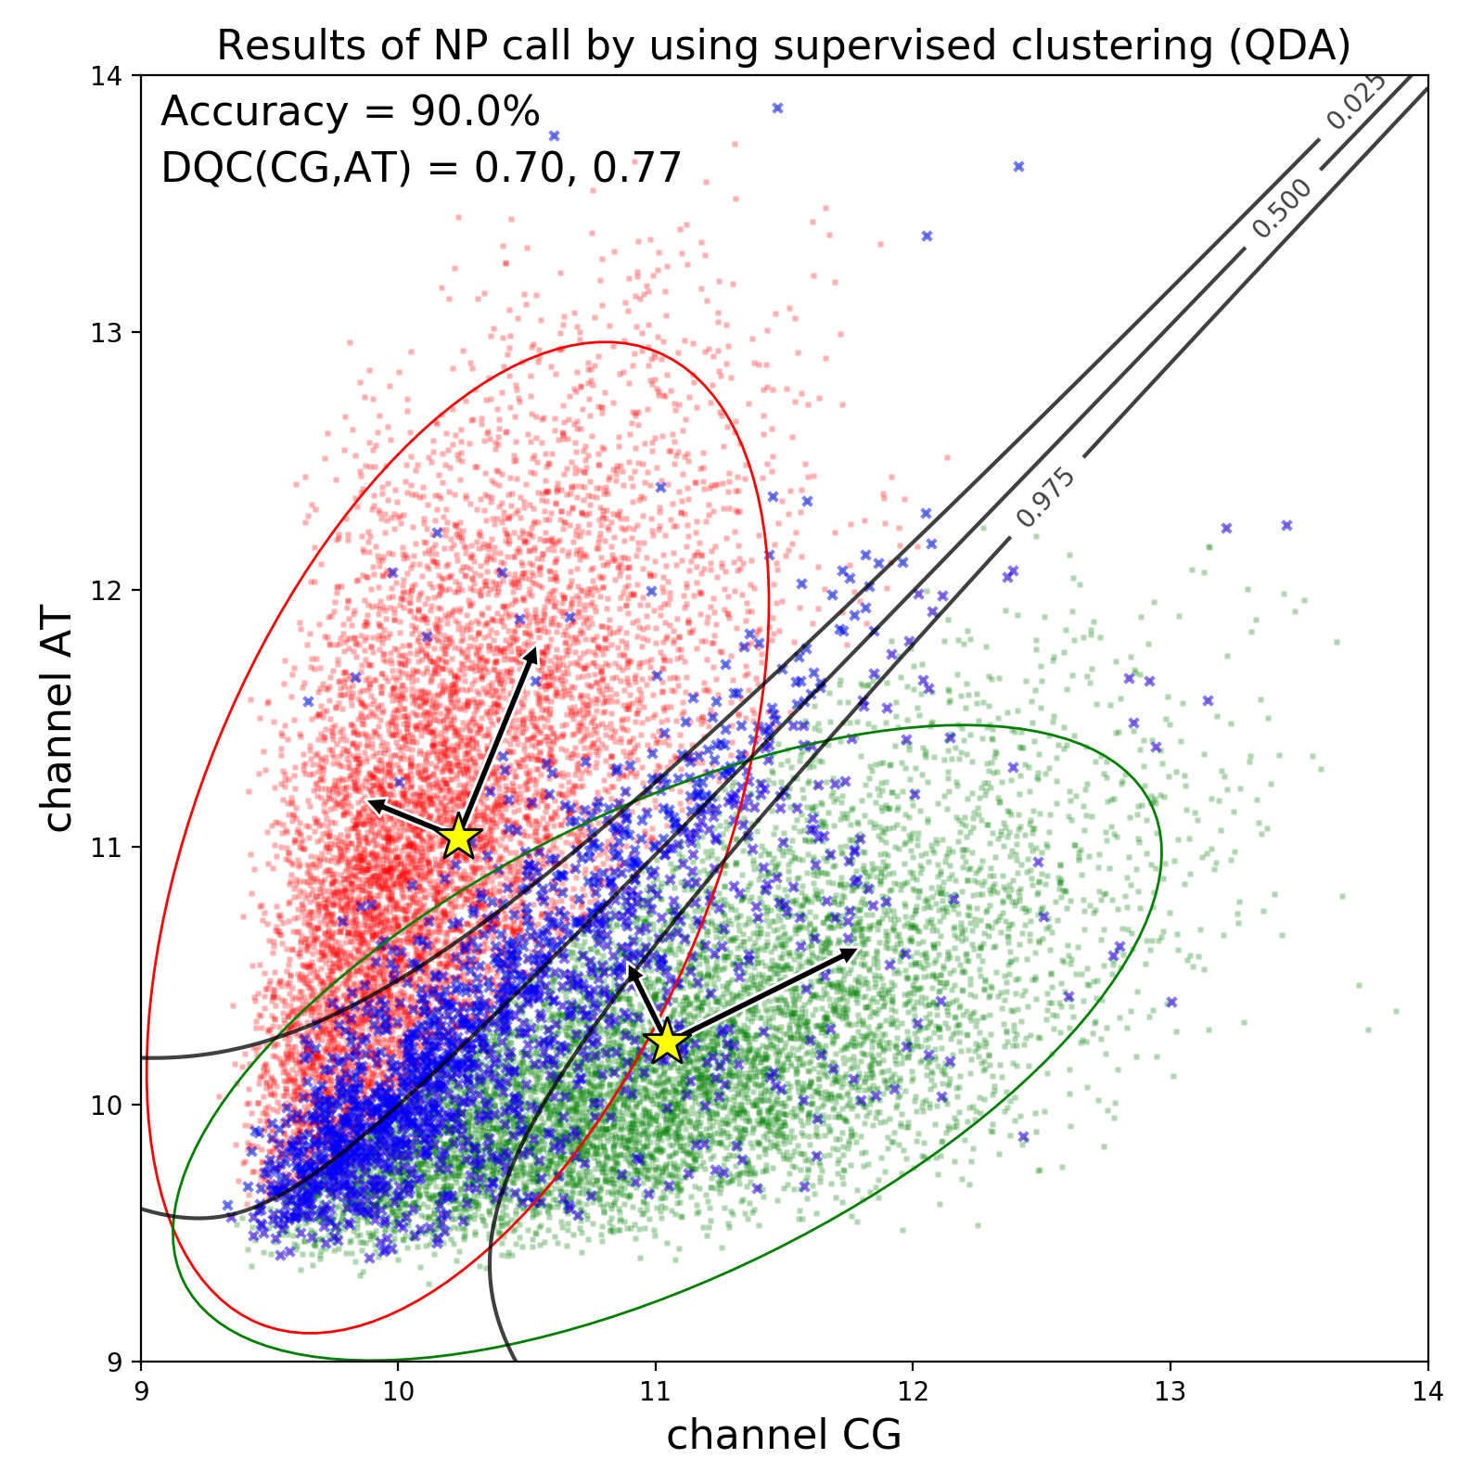
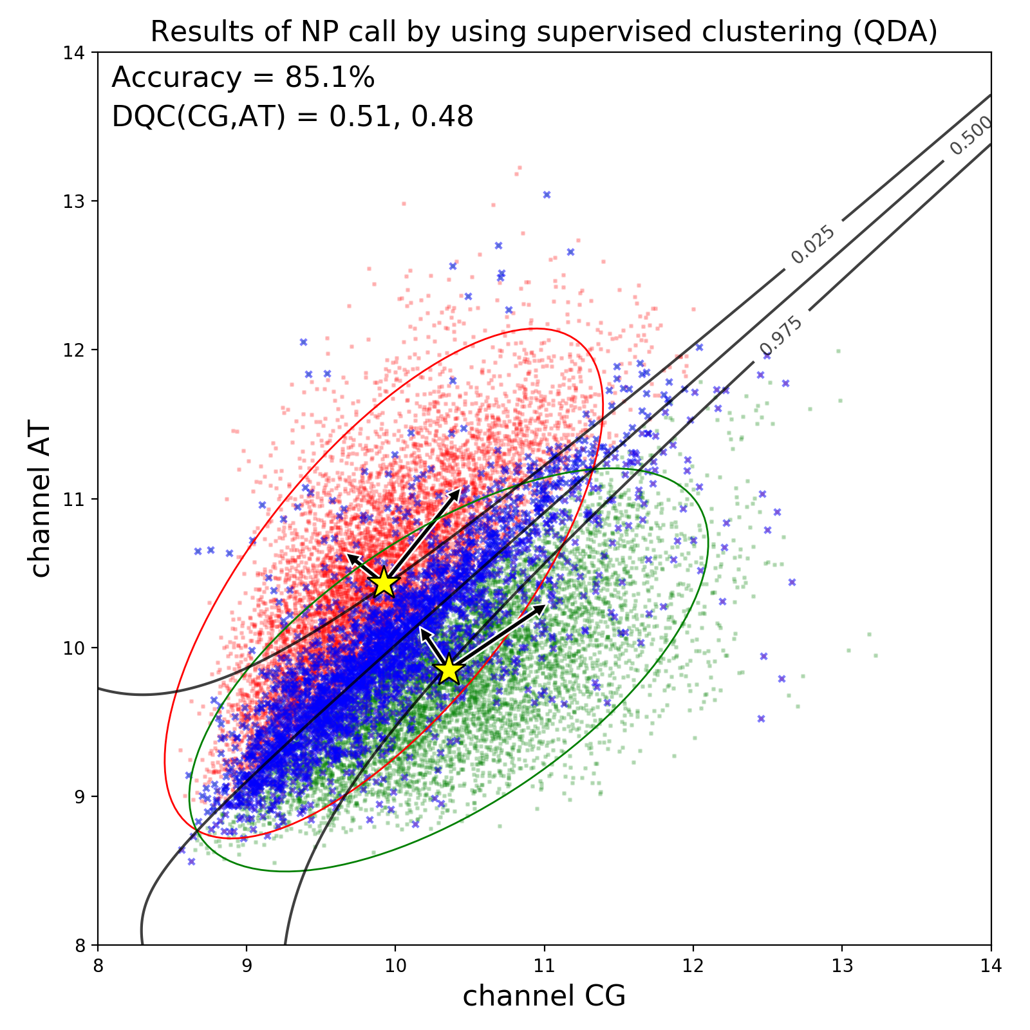

Data Preprocess
Data Example
94.4
90.0
Wafer | Chips | Np call rate (%) (NP call Analyzer)
198-04 | 121 | 94.4
197-02 | 230 | 90.0
198-15 | 277 | 85.1
197-02 | 233 | 78.7
85.1
78.7

Slide 30


Data Preprocess
Logarithm Effect

Slide 31


Data Preprocess
Logarithm Effect

Slide 32
Chip QC and NPcall Analyzer
Jeff (CHI-HSUAN HO)

Slide 33


Summit.NPCallAnalyzer
Chip No.54 Quality Control Chip NO.62 Quality Control

Slide 34


Summit.NPCallAnalyzer
A
B
C
Snowy rate $=\frac{x in B}{all points in A+B+C}$

Slide 35




Summit.NPCallAnalyzer
GMM-EM Results (log(log))
Misclassified data
NP call: 94.2308%
No Call Rate: 66.8298%

Slide 36

Banff chip QC – Violin Plot

Slide 37

Banff chip QC – Heatmap

Slide 38

Banff chip QC – Marker Raw Data

Slide 39


Correlation and Regression analysis (MCE vs. NP call)
Training data: 80% data
Model: $NPcall=−0.005+1.005∙(1−MCE)$
$R^{2}$: 99.96%
Testing data: 20% data
MSE: 5.999574703240224e-06
It still need NP data to calculate the MCE.

